Slide 1
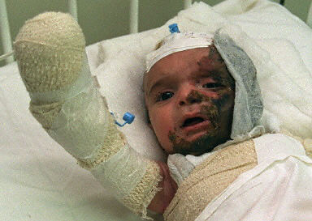
From the Diary of an Almost 4-Year Old
By Hanan Mikhael Ashrawi
Tomorrow the bandages will come off,
I wonder, will I see half an oven? Half an apple?
Half my mother's face with my one remaining eye?
I did not see the bullet
But felt its pain exploding in my head.
his image did not disintegrate.
The soldier with his big gun and steady hands.
And the look in his eyes I could not understand.
I can see him so clearly with my eyes closed,
It could be that inside our heads.
We each have one spare set of eyes
To make up for the ones we lose.
Next month, on my birthday,
I'll have a brand new glass eye
Maybe things will look round and fat at the middle.
I gaze through all my marbles,
They make the world look strange.
I hear a nine-month-old has also lost an eye,
I wonder if my soldier shot her too,
A soldier looking for little girls who look him in the eye.
I'm old enough, almost four,
I've seen enough of life
But she's just a baby
Who didn't know any better.

Slide 2
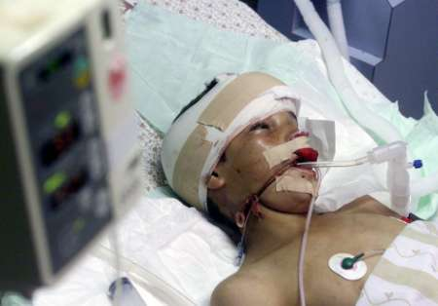
A Palestinian boy

Slide 3
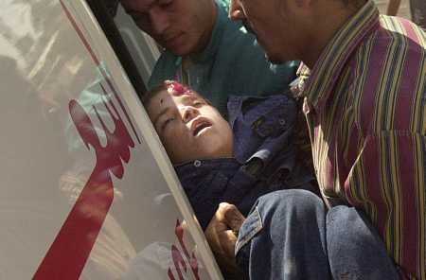
was shot in the head

Slide 4
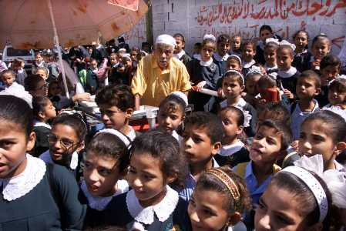
Earlier in school

Slide 5
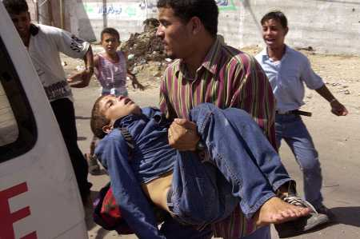
He didn’t expect

Slide 6
WHY?

Slide 7
Because he is a terrorist, that’s why

Slide 8
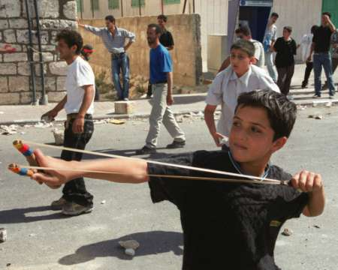
He has to know that throwing stones

Slide 9
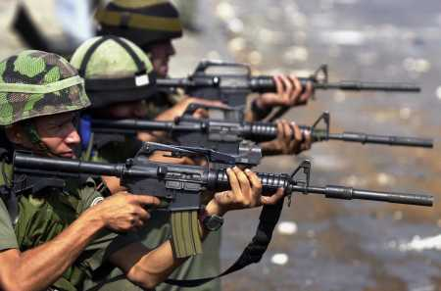
will only mean breaking his bones

Slide 10
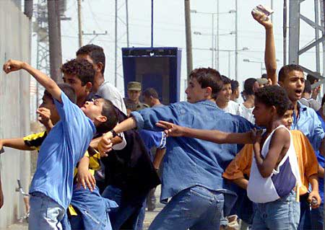
They are terrorists and the world must know

Slide 11
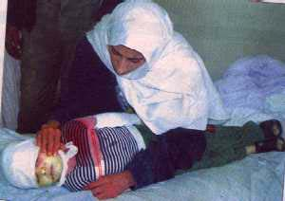
in front of kids, we don’t shoot low

Slide 12
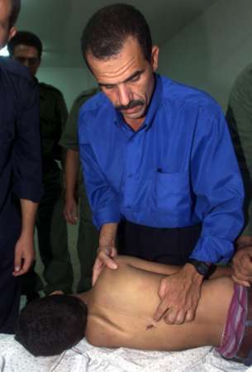
With a shot to the head, or to the back

Slide 13
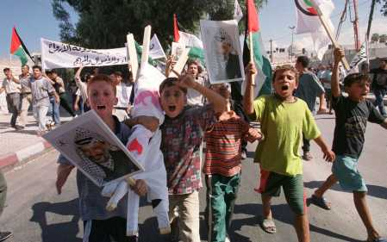
In any demonstration

Slide 14
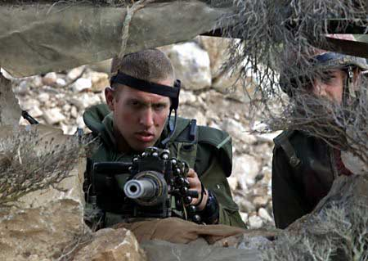
We’ll shoot back

Slide 15
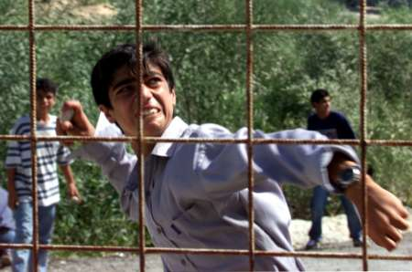
These violent boys just make you ill

Slide 16
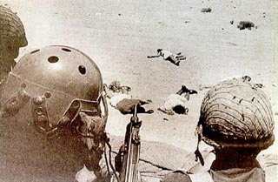
How many more we must kill ?

Slide 17
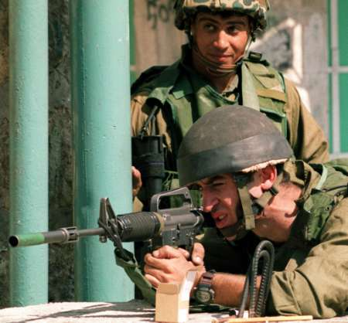
We’ll kill ’em all, Sharon said

Slide 18
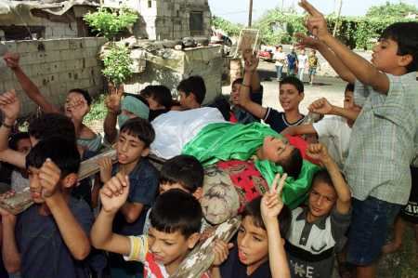
We can definitely defeat a bunch of kids

Slide 19
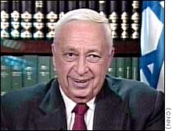
Hey America, we need more aid

Slide 20
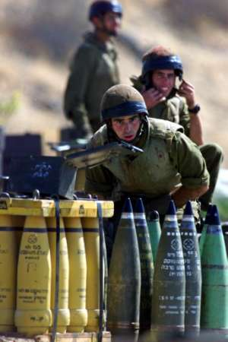
Our weapons are not up to date

Slide 21
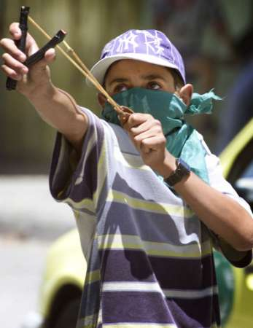
We face grave danger from boys so young

Slide 22
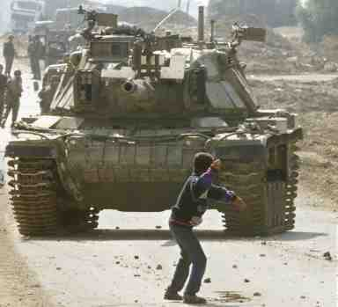
And we only have some tanks and guns

Slide 23
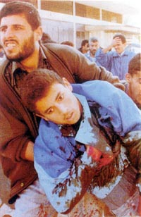
We will kill them old

Slide 24
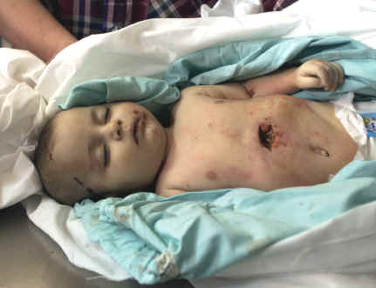
And will kill them young

Slide 25
With a shot to the head

Slide 26
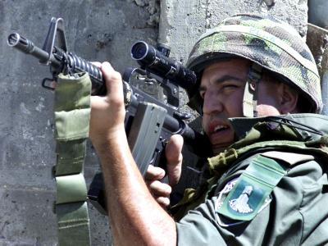
Or to the lung

Slide 27
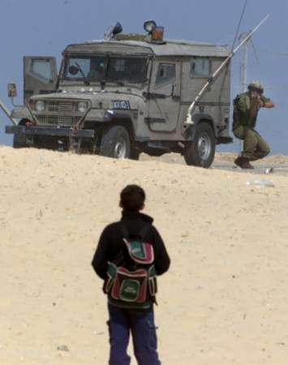
Shoot this boy

Slide 28
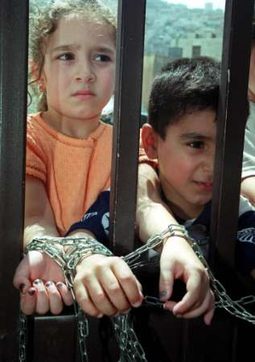
And these two

Slide 29
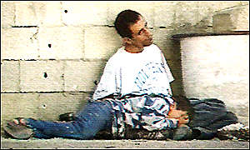
And while we’re at it

Slide 30
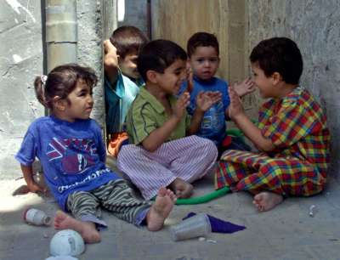
Let’s kill these too

Slide 31
THE FACTS

Slide 32
Nearly 2000 Palestinians were killed in the past year
most of them are under the age of 15

Slide 33
Nearly 25,000 Palestinians were seriously injured

Slide 34
Please help us protect our children from the zionist jews
Make an effort and forward this presentation to your friends
 May Peace be with you 

